Slide 1
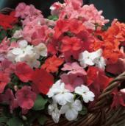
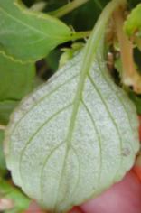
Impatiens Downy Mildew
Contributions by (alphabetically):
Brian E. Corr
Dean Mosdell
Nancy Rechcigl
Darryl L. Thomas
Jane Trolinger
©2012 Syngenta. Classification: PUBLIC. Reproduced with the permission of Syngenta.

Slide 2
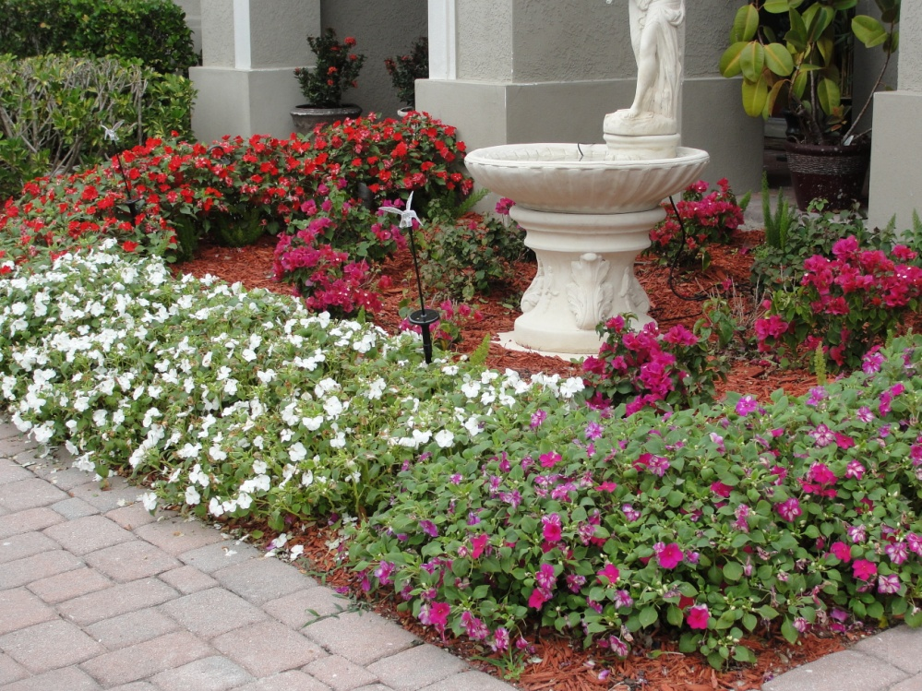
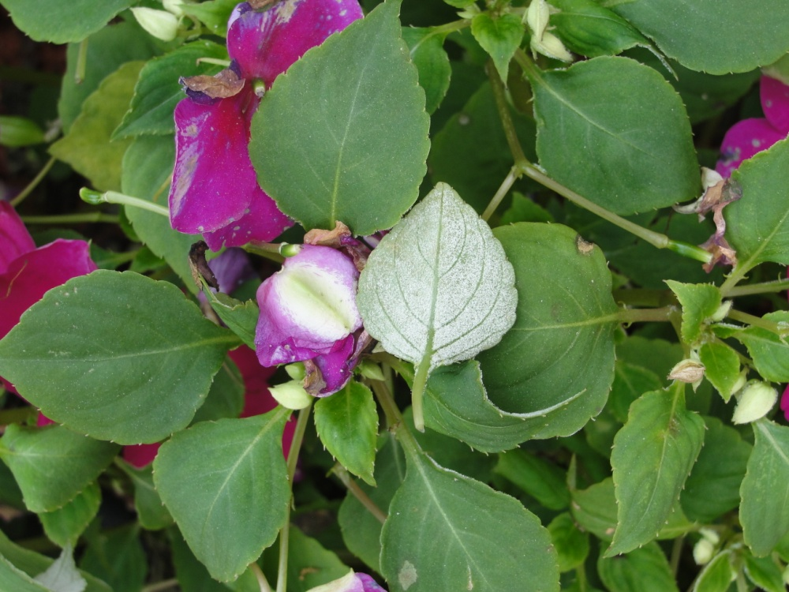
Impatiens are popular plants in the landscape
Rechcigl
Rechcigl
©2012 Syngenta. Classification: PUBLIC. Reproduced with the permission of Syngenta.

Slide 3
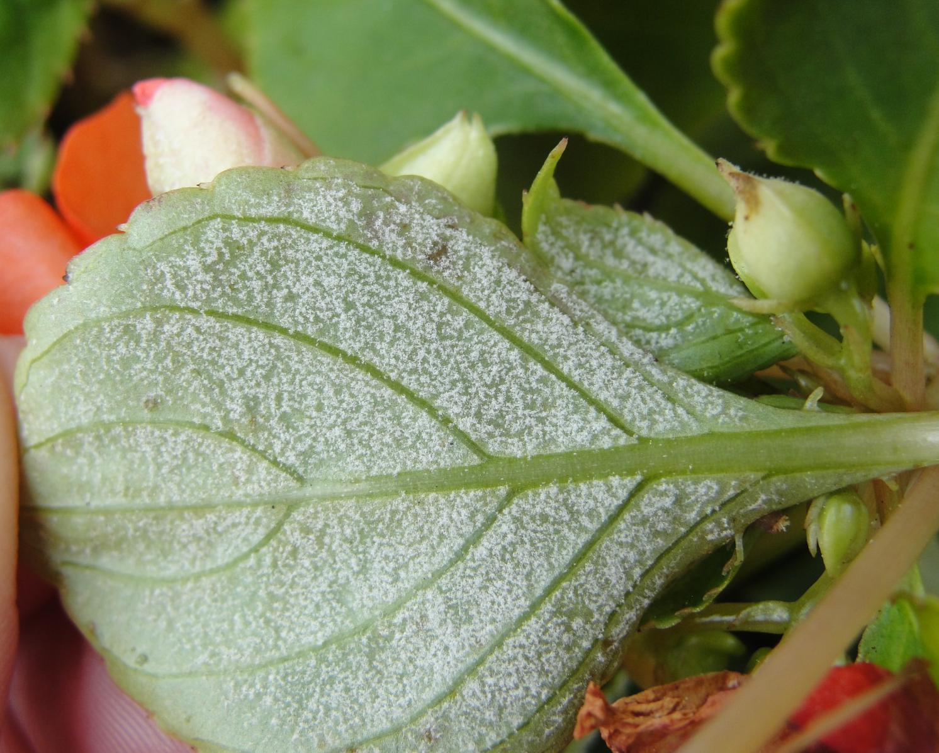
Heavy sporulation on the underside of the leaves
Rechcigl
©2012 Syngenta. Classification: PUBLIC. Reproduced with the permission of Syngenta.

Slide 4
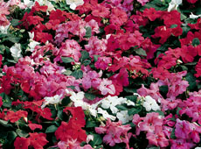
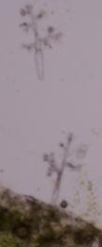
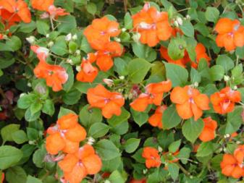
Introduction
Destructive foliar disease of the common garden impatiens, Impatiens walleriana and also garden balsam (I. balsamina)
All cultivars of I. walleriana are susceptible as well as all interspecific hybrids with I. walleriana as a parent; New Guinea Impatiens (I. hawkeri) are highly tolerant
Primary causal agent: Plasmopara obducens
Trolinger
Rechcigl
HEALTHY
PLASMOPARA OBDUCENS
DISEASED
©2012 Syngenta. Classification: PUBLIC. Reproduced with the permission of Syngenta.

Slide 5
Historical background
Plasmopara obducens present in the U.S. since late 1800’s
Reported on Impatiens pallida and I. capensis (native species of N. America)
First reported as problem in UK (2003)
Often a devastating disease outside of North America
Found in U.S. greenhouse production in spring of 2004
2004 reports included locations in the U.S.: CA, IN, MI, MN, MS, MO, WI and WV and Manitoba and Quebec in Canada
Sporadic reports in U.S. since 2004
More severe in 2011 and reported in: coastal southern CA; HI; northeast IL; northern IN; Cape Cod, MA; Minneapolis/St. Paul, MN; NY; eastern PA; and northern WI
Outside of North America and Europe, reported in: Australia, Asia, Africa, Central and South America
©2012 Syngenta. Classification: PUBLIC. Reproduced with the permission of Syngenta.
Notes:
CA = California, IN = Indiana, MI = Michigan, MN = Minnesota, MS = Mississippi, MO = Missouri, WI = Wisconsin, WV = West Virginia, IL = Illinois, MA = Massachusetts, PA = Pennsylvania, NY = New York

Slide 6
Biology
Two species of downy mildew reported on Impatiens: Plasmopara obducens (primary) and Bremiella sphaerosperma
Water molds or oomycetes
Parasitic on Impatiens and does not threaten other flower crops
Zoospores are the primary spores which cause infection – can swim, produced in sporangia on sporangiophores (emerge on undersides of leaves)
Sporangia released in response to light, temperature and/or humidity changes
  Spread through air and water
Cool, moist conditions (59-73°F/15-23°C) conducive to sporangia formation and zoospore germination
Period between infection and visible sporulation varies between 5 -14 days
©2012 Syngenta. Classification: PUBLIC. Reproduced with the permission of Syngenta.

Slide 7
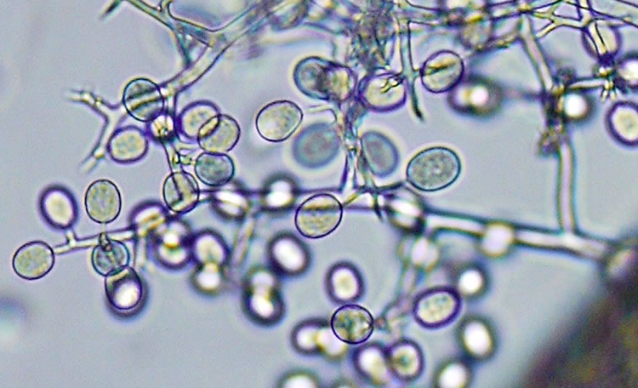
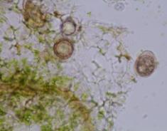
Biology (cont.)
Sporulation may not occur and symptoms may be subtle in dry and warm conditions
  Can result in inadvertent movement of infected plants
Oospores – responsible for survival (long-lived)
  Formed in leaves and stems (roots not studied thoroughly)
  Accompany infected plant debris
  Survive to 5°F (-15°C) in landscapes (USDA Hardiness Zone 5)
NOT seed transmitted
Trolinger
Hausbeck
OOSPORES
PLASMOPARA OBDUCENS
©2012 Syngenta. Classification: PUBLIC. Reproduced with the permission of Syngenta.

Slide 8
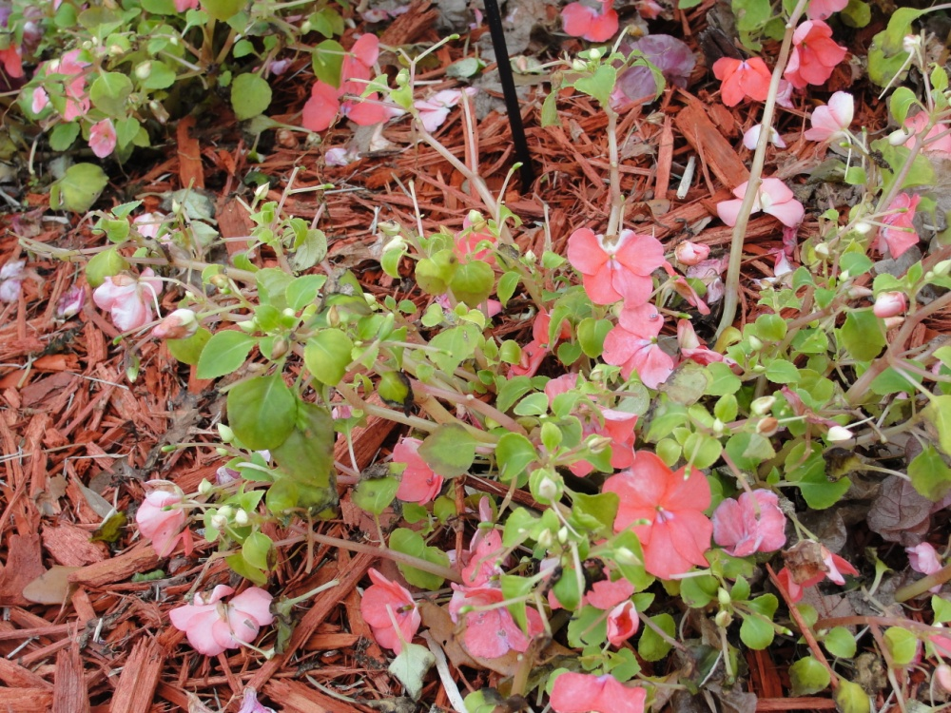
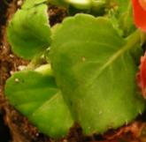
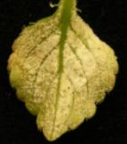
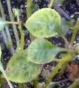
Symptoms
Yellow to pale green foliage and mild, inconspicuous mottling
Can be mistaken for:
  Nutritional imbalance
  Spray injury
  Chilling
  Spider mite infestation
Advanced symptoms
  Stunting of plant growth/malformation of leaves and flower buds
  Downward curling/distortion of foliage
  Wilting
  Plant collapse
  Severe defoliation
Symptoms can be delayed or masked by high fertility levels
Rechcigl
Trolinger
Mosdell
©2012 Syngenta. Classification: PUBLIC. Reproduced with the permission of Syngenta.

Slide 9
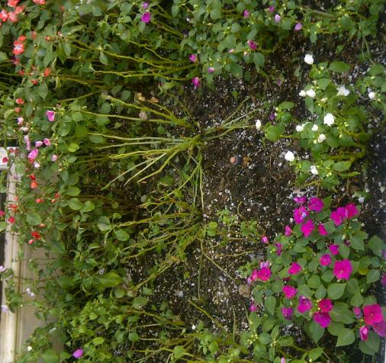
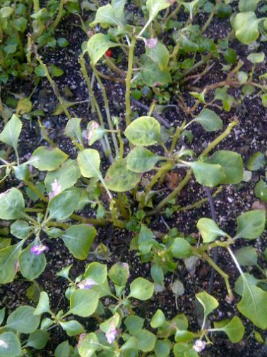
Severe defoliation as the disease progresses
Dean Mosdell
Dean Mosdell
©2012 Syngenta. Classification: PUBLIC. Reproduced with the permission of Syngenta.

Slide 10
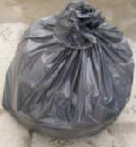
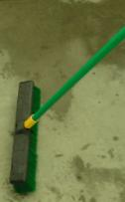
Cultural control
PREVENTION
  Disease-free propagation material
  Segregate vegetatively propagated from seed propagated
  Maintain moderate humidity
  Avoid extended periods of foliage moisture
  Irrigate early in day
  Employ sound greenhouse sanitation practices
  Use a regular preventive fungicide program
  Scout crop frequently/identify suspects
  Submit to lab for confirmation
AFTER CONFIRMATION
  Place all symptomatic plants and debris in closed bags
  Remove from greenhouse
  Remove and discard plants from buffer of at least 3 ft. radius
  Use approved greenhouse disinfectant
  Begin enhanced preventive fungicide program
Trolinger
©2012 Syngenta. Classification: PUBLIC. Reproduced with the permission of Syngenta.

Slide 11
Products for control of Downy Mildew in production
MOA (FRAC#) | Product | Active Ingredient | Activity | Application | REI | Company
4 | Subdue MAXX® fungicide | Mefenoxam | Systemic | Spray Drench | 48 hr REI exemptions (0 hr) for certain drench applications | Syngenta
11 | Heritage® fungicide | Azoxystrobin | Systemic | Spray | 4 hr | Syngenta
11 | Disarm® O fungicide | Fluoxastrobin | Systemic | Spray | 12 hr | OHP
11 | Fenstop™ fungicide Greenhouse Use Only | Fenamidone | Systemic | Spray | 12 hr | OHP
11+7 | Pageant™ fungicide | Pyraclostrobin + Boscalid | Translaminar (11) + Systemic (7) | Spray | 12 hr | BASF
21 | Segway™ fungicide | Cyazofamid | Translaminar | Spray | 12 hr | FMC
33 | Aliette® fungicide | Fosetyl-AL | Systemic | Spray | 12 hr | OHP/Bayer
33 | Alude™ fungicide | Potassium salts of Phosphorous Acid | Systemic | Spray | 4 hr | Cleary Chemical Corp.
33 | Vital® fungicide | Potassium phosphite | Systemic | Spray | 4 hr | Phoenix
40 | Micora™ fungicide | Mandipropamid | Translaminar | Spray | 4 hr | Syngenta
40 | Stature® SC fungicide | Dimethomorph | Translaminar | Spray | 12 hr | BASF
43 | Adorn® fungicide | Fluopicolide | Systemic | Spray Drench | 12 hr | Valent
M | Protect™ DF fungicide | Mancozeb | Contact | Spray | 24 hr | Cleary Chemical Corp.
NOTES:
Always test products on a small area before using on an entire crop.
For brevity some products with the same mode of action have been omitted.
All products may not be registered for sale or use in all states. Please check with your state or local extension service before buying or using Syngenta products.
©2012 Syngenta. Classification: PUBLIC. Reproduced with the permission of Syngenta.

Slide 12
Fungicide evaluation for control of Downy Mildew (Plasmopara obducens) on impatiens
Treatments | Rate/100 gal | Wilt 12/6 | Wilt 1/17 | Oospores (stem)
Inoculated |  | 1.3 a | 2.7 a | +
Non-inoculated Control |  | 1.2 a | 1.8 a | +
Micora | 8 oz (Spray) | 0 b | 0 b | -
Subdue MAXX | 1 fl.oz (Spray) | 0 b | 0 b | -
Subdue MAXX | 1 fl.oz (drench) | 0 b | 0 b | -
Heritage + Capsil® wetting agent | 4oz + 4oz (Spray) | 0 b | 0 b | -
Stature SC | 12.8oz (Spray) | 0 b | 0 b | -
Wilt rating 0 – 4 scale; 0 = no wilt; 1=25%; 2=25-75%; 3=75-99%; 4 = completely wilted plant – 10 reps/trt
All products may not be registered for sale or use in all states. Please check with your state or local extension service before buying or using Syngenta products.
2011 – Daughtrey, Cornell University
©2012 Syngenta. Classification: PUBLIC. Reproduced with the permission of Syngenta.

Slide 13
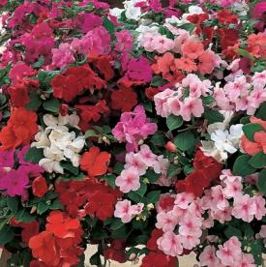
Examples of prevention programs
Production of Finished Plants
Plugs
 | Week Post-Transplant | Application | Fungicide FRAC # | Target Diseases
4 inch pot or smaller | 1 | Recommended Drench | 4 + 43 | Pythium, Phytophthora, Downy Mildew
 | 2 | Optional Treatment | M | Downy mildew, Leafspots, Botrytis
 | 3 | Recommended Treatment | 40 | Downy Mildew
 | 4 | Optional Treatment | 11 | Downy Mildew, Leafspots, Botrytis
 | 5 | Recommended Treatment | 33 | Downy Mildew, *Pythium, Phytophthora (drench)
 | 6 | Optional Treatment | 11 | Downy Mildew, Leafspots, Botrytis
 | 7 | Recommended Treatment | 40 | Downy Mildew
6 inch pot | 8 | Optional Treatment | 11 | Downy Mildew Leafspots, Botrytis
 | 9 | Recommended Treatment (drench) | 4 + 33 or 4 + 43 | Downy Mildew, *Pythium, Phytophthora (drench)
 | 9 | Recommended Treatment | 40 | Downy Mildew
Larger containers | 10 | Optional Treatment | 11 or 21 | Downy Mildew, Leafspots
 | 11 | Recommended Treatment (drench) | 4 + 33 or 4 + 43 | Downy Mildew, *Pythium, Phytophthora (drench)
Propagation Week | Plugs (Seed or URC)
1
2 | Drench – 21 or 4
3
4 | Spray – M or 11
*Additional diseases controlled with drench application
~A mancozeb product may be added to the suggested
spray treatments for additional protection as plant
tolerance and production schedules allow.
©2012 Syngenta. Classification: PUBLIC. Reproduced with the permission of Syngenta.

Slide 14
Example of a Downy Mildew prevention rotation
Crop | Week (post-transplant) | Application | FRAC # | Fungicide (example) | Target Diseases
4 inch pot or smaller | 1 | Recommended treatment (drench) | 4+43 | Subdue MAXX + Adorn | Pythium, Phytophthora, Downy Mildew
 | 2 | Optional treatment (spray) | M | Protect DF | Downy Mildew, Leafspots, Botrytis
 | 3 | Recommended treatment (spray) | 40 + M** | Micora Protect DF optional | Downy Mildew
 | 4 | Optional treatment (spray) | 11+ M** | Heritage Protect DF optional | Downy Mildew, Leafspots, Botrytis
 | 5 | Recommended treatment (spray or drench) | 33 | Vital® | Downy Mildew, *Pythium, Phytophthora
 | 6 | Optional treatment (spray) | 11 + M** | Heritage Protect DF optional | Downy Mildew Leafspots, Botrytis
6 inch pot | 7 | Recommended treatment (spray) | 40 | Micora Protect DF optional | Downy Mildew
 | 8 | Optional treatment (spray) | 11 | Heritage Protect DF optional | Downy Mildew Leafspots, Botrytis
 | 9 (final week) | Recommended treatment (drench) | 4+33 or 4+43 | Subdue MAXX + Vital or Subdue MAXX + Adorn | Downy Mildew, *Pythium, Phytophthora
Larger containers | 9 | Recommended treatment (spray) | 40 | Micora | Downy Mildew
 | 10 | Optional treatment (spray) | 11 or 21 | Heritage or Segway | Downy Mildew, Leafspots, Botrytis
 | 11 (final week) | Recommended treatment (drench) | 4+33 or 4+43 | Subdue MAXX + Vital or Subdue MAXX + Adorn | Downy Mildew, *Pythium, Phytophthora
* Additional diseases controlled with a drench application
**A mancozeb product may be added to the suggested spray treatments for additional protection as plant tolerance and production schedules allow
All products may not be registered for sale or use in all states. Please check with your state or local extension service before buying or using Syngenta products.
©2012 Syngenta. Classification: PUBLIC.
Reproduced with the permission of Syngenta.

Slide 15
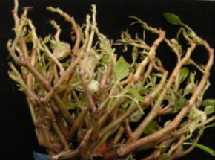
A sound management program should include:
Sanitation/scouting
Rotation of effective fungicides with different modes of action (Fungicide Resistance Action Committee (FRAC))
Foliar sprays and periodic drenches to growing medium to maximize efficacy
A drench treatment prior to shipment with FRAC # (33 + 4) or (4 + 43) fungicides to minimize risk of early infection in the landscape
Recommend impatiens not be replanted into landscape beds where downy mildew of impatiens was identified the previous season
Rechcigl
Trolinger
©2012 Syngenta. Classification: PUBLIC. Reproduced with the permission of Syngenta.

Slide 16
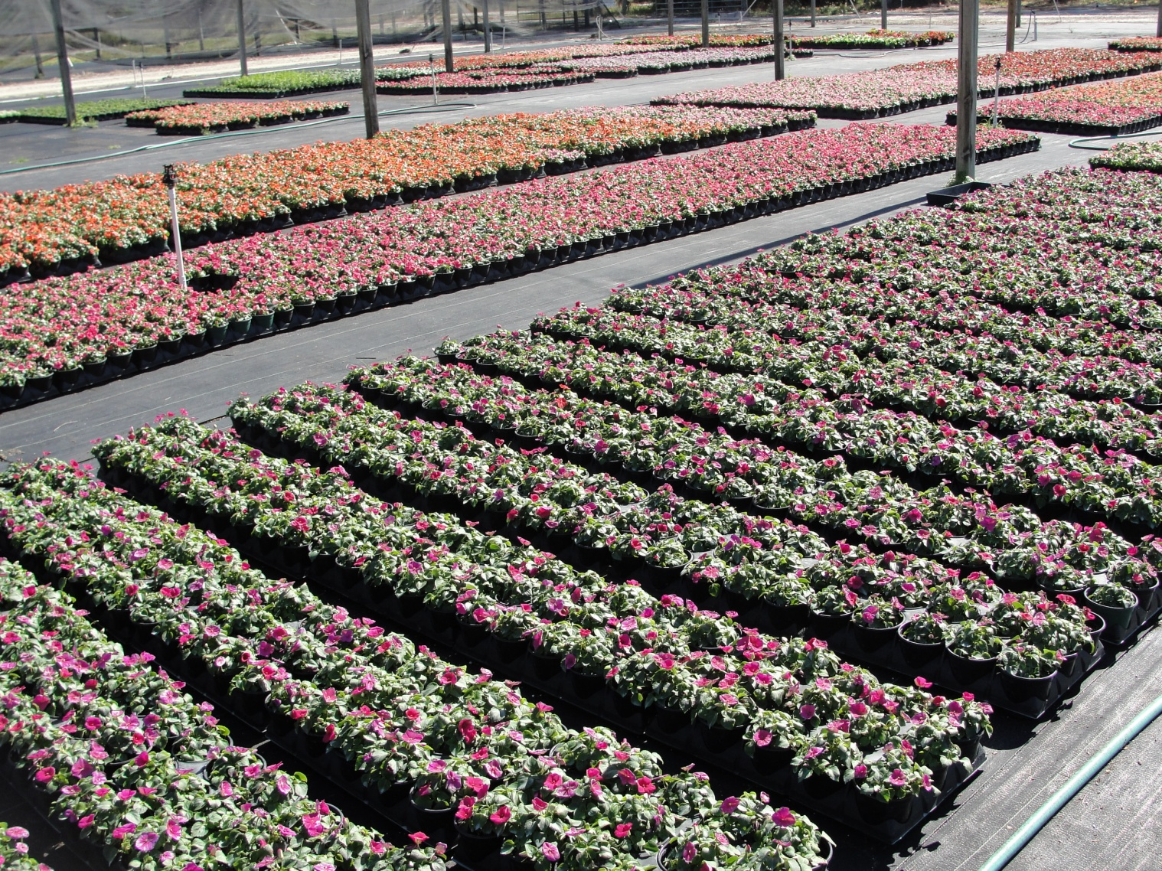
Thank You ~ Questions
Rechcigl
Rechcigl
©2012 Syngenta. Classification: PUBLIC. Reproduced with the permission of Syngenta.

Slide 17
Legal
©2012 Syngenta. Important: Always read and follow label instructions before buying or using Syngenta products. The label contains important conditions of sale, including limitations of warranty and remedy. All products may not be registered for sale or use in all states. Please check with your state or local extension service before buying or using Syngenta products. Syngenta supports a FIFRA Section 2(ee) recommendation for the use of Heritage for control of downy mildew on bedding plants caused by Plasmopara spp. Please see the Section 2(ee) recommendation to confirm that the recommendation is applicable in your state. Some or all of the varieties may be protected under one or more of the following: Plant Variety Protection, United States Plant Patents, Utility Patents, and/or Plant Breeders’ Rights and may not be propagated or reproduced without authorization. Heritage®, Micora™ and Subdue MAXX® are trademarks of a Syngenta Group Company. Disarm® and Fenstop™ are trademarks of OHP, Inc. Pageant™ and Stature® are trademarks of BASF. Segway™ is a trademark of Ishihana Sangyo Kaisha, Ltd. Aliette® is a registered trademark of Bayer CropScience. Alude™ and Protect® are trademarks of the Cleary Chemical Corporation. Adorn® is a registered trademark of Valent U.S.A. Corporation. Vital® is a registered trademark of Phoenix Environmental Care, LLC. Capsil® is a registered trademark of Aquatrols.
©2012 Syngenta. Classification: PUBLIC. Reproduced with the permission of Syngenta.

